Slide 1
It’s a Matter of Time
CHAPTER 5

Slide 2
Show the result as a line chart for each day in the year, with the
number of orders on the left axis and the average dollars on the right axis.
p. 189 Figure 5-1:
SELECT MONTH(orderdate)*100+DAY(orderdate) as monthday,
COUNT(*) as numorders, AVG(totalprice) as avgtotalprice
FROM orders
GROUP BY MONTH(orderdate)*100+DAY(orderdate)
ORDER BY 1

Slide 3
How many customers were sent shipments and bills on each day?
Figure 5-2 p.195
The number of items in an order and the number billed so closely track each
other that the chart is difficult to read.
SELECT thedate, SUM(numship) as numships, SUM(numbill) as numbill,
SUM(numcustship) as numcustship, SUM(numcustbill) as numcustbill
FROM ((SELECT shipdate as thedate, COUNT(*) as numship, 0 as numbill,
COUNT(DISTINCT customerid) as numcustship,
0 as numcustbill
FROM orderline ol JOIN orders o ON ol.orderid = o.orderid
GROUP BY shipdate
) UNION ALL
(SELECT billdate as thedate, 0 as numship, COUNT(*) as numbill,
0 as numcustship,
COUNT(DISTINCT customerid) as numcustbill
FROM orderline ol JOIN orders o ON ol.orderid = o.orderid
GROUP BY billdate)) a
GROUP BY thedate
ORDER BY 1

Slide 4
What is the product group of the most popular product during each month?
Figure 5-5 p.199
SELECT prodmon.yr, prodmon.mon, prodmon.cnt, p.productgroupname
FROM (SELECT YEAR(orderdate) as yr, MONTH(orderdate) as mon, productid, COUNT(*) as cnt
FROM orders o JOIN orderline ol ON o.orderid = ol.orderid
GROUP BY YEAR(orderdate), MONTH(orderdate), productid
) prodmon JOIN
(SELECT yr, mon, MAX(cnt) as maxcnt
FROM (SELECT YEAR(orderdate) as yr, MONTH(orderdate) as mon,productid, COUNT(*) as cnt
FROM orders o JOIN orderline ol ON o.orderid = ol.orderid
GROUP BY YEAR(orderdate), MONTH(orderdate), productid) c
GROUP BY yr, mon
) prodmax
ON prodmon.yr = prodmax.yr AND prodmon.mon = prodmax.mon AND
prodmon.cnt = prodmax.maxcnt JOIN
product p
ON prodmon.productid = p.productid
ORDER BY 1, 2

Slide 5
How long after the order is placed are
items shipped? How long after the order is placed are items billed?
Figure 5-8 p. 206
The delay from ordering to shipping is shown here, both as a histogram and
a cumulative proportion
SELECT DATEDIFF(dd, o.orderdate, ol.shipdate) as days, COUNT(*) as numol
FROM orders o JOIN orderline ol ON o.orderid = ol.orderid
GROUP BY DATEDIFF(dd, o.orderdate, ol.shipdate)
ORDER BY 1

Slide 6
How many customers were active on any given day in the past?
224
SELECT thedate, SUM(nstarts) as nstarts, SUM(nstops) as nstops
FROM ((SELECT (CASE WHEN start_date >= ‘2003-12-31’ THEN start_date
ELSE ‘2003-12-31’ END) as thedate,
COUNT(*) as nstarts, 0 as nstops
FROM subs
WHERE start_date IS NOT NULL
GROUP BY (CASE WHEN start_date >= ‘2003-12-31’ THEN start_date
ELSE ‘2003-12-31’ END) )
UNION ALL
(SELECT (CASE WHEN stop_date >= ‘2003-12-31’
THEN stop_date ELSE ‘2003-12-31’ END) as thedate,
0 as nstarts, COUNT(*) as nstops
FROM subs
WHERE start_date IS NOT NULL AND stop_date IS NOT NULL
GROUP BY (CASE WHEN stop_date >= ‘2003-12-31’
THEN stop_date ELSE ‘2003-12-31’ END) )
) a
GROUP BY thedate
ORDER BY 1

Slide 7
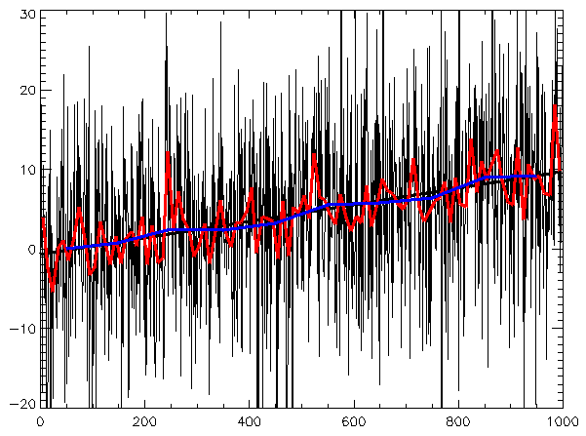
Time series (wiki)
Time series: random data plus trend, with best-fit line and different applied filters
The Fourier transform relates the function's time domain, shown in red, to the function's frequency domain, shown in blue.
Methods for time series analyses may be divided into two classes: frequency-domain methods and time-domain methods.
The former include spectral analysis and recently wavelet analysis; the latter include auto-correlation and cross-correlation analysis.

Slide 8
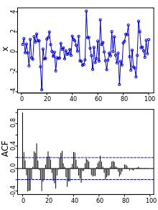

Autocorrelation
Above: A plot of a series of 100 random numbers concealing a sine function. Below: The sine function revealed in a correlogram produced by autocorrelation.

Slide 9
Time series (wiki)
Methods for time series analyses
Additionally, time series analysis techniques may be divided into parametric and non-parametric methods.
The parametric approaches assume that the underlying stationary stochastic process has a certain structure which can be described using a small number of parameters (for example, using an autoregressive or moving average model). In these approaches, the task is to estimate the parameters of the model that describes the stochastic process.
By contrast, non-parametric approaches explicitly estimate the covariance or the spectrum of the process without assuming that the process has any particular structure.
Methods of time series analysis may also be divided into linear and non-linear, and univariate and multivariate.

Slide 10
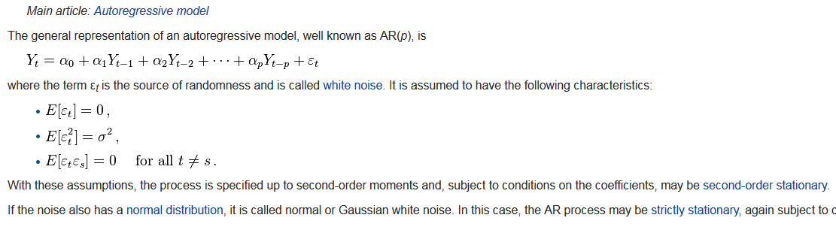
Autoregressive model

Slide 11
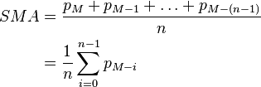
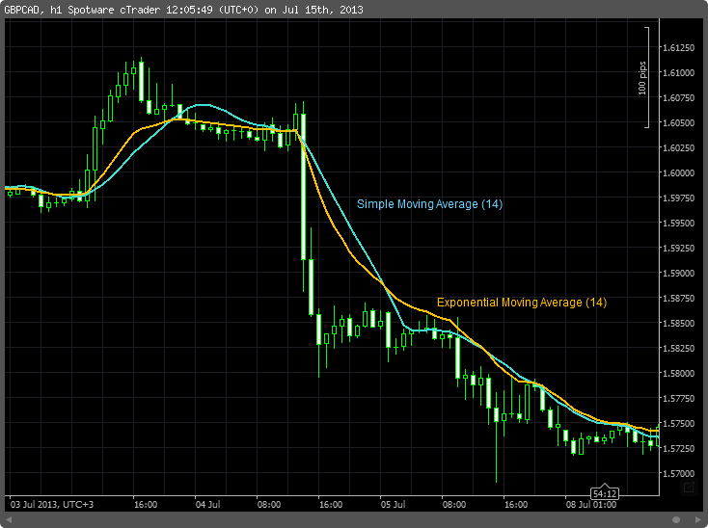
Simple moving average

Slide 12
Time series (wiki) Motivation
In the context of statistics, econometrics, quantitative finance, seismology, meteorology, and geophysics the primary goal of time series analysis is forecasting.
In the context of signal processing, control engineering and communication engineering it is used for signal detection and estimation,
while in the context of data mining, pattern recognition and machine learning time series analysis can be used for clustering, classification, query by content, anomaly detection as well as forecasting.

Slide 13
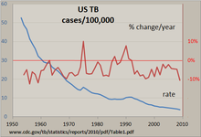
Time series (wiki) Exploratory analysis
The clearest way to examine a regular time series manually is with a line chart such as the one shown for tuberculosis in the United States, made with a spreadsheet program. The number of cases was standardized to a rate per 100,000 and the percent change per year in this rate was calculated. The nearly steadily dropping line shows that the TB incidence was decreasing in most years, but the percent change in this rate varied by as much as +/- 10%, with 'surges' in 1975 and around the early 1990s. The use of both vertical axes allows the comparison of two time series in one graphic. Other techniques include:
Autocorrelation analysis to examine serial dependence
Spectral analysis to examine cyclic behaviour which need not be related to seasonality. For example, sun spot activity varies over 11 year cycles.^{[3][4]} Other common examples include celestial phenomena, weather patterns, neural activity, commodity prices, and economic activity.
Separation into components representing trend, seasonality, slow and fast variation, and cyclical irregularity: see trend estimation and decomposition of time series

Slide 14
Using R for Time Series Analysis
http://a-little-book-of-r-for-time-series.readthedocs.io/en/latest/src/timeseries.html
Reading Time Series Data
Plotting Time Series
Decomposing Time Series
Decomposing Non-Seasonal Data
Decomposing Seasonal Data
Forecasts

